Slide 1
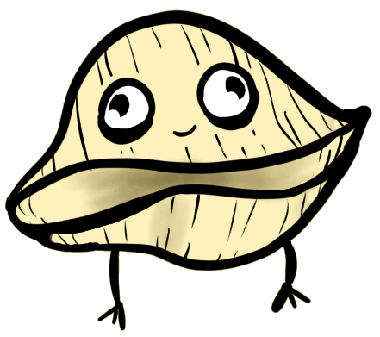
PASTA HARMONIA
TEAM ARIGATO

Slide 2
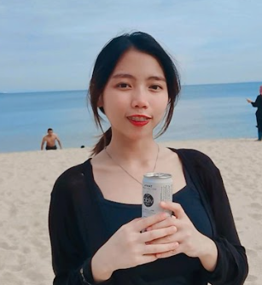
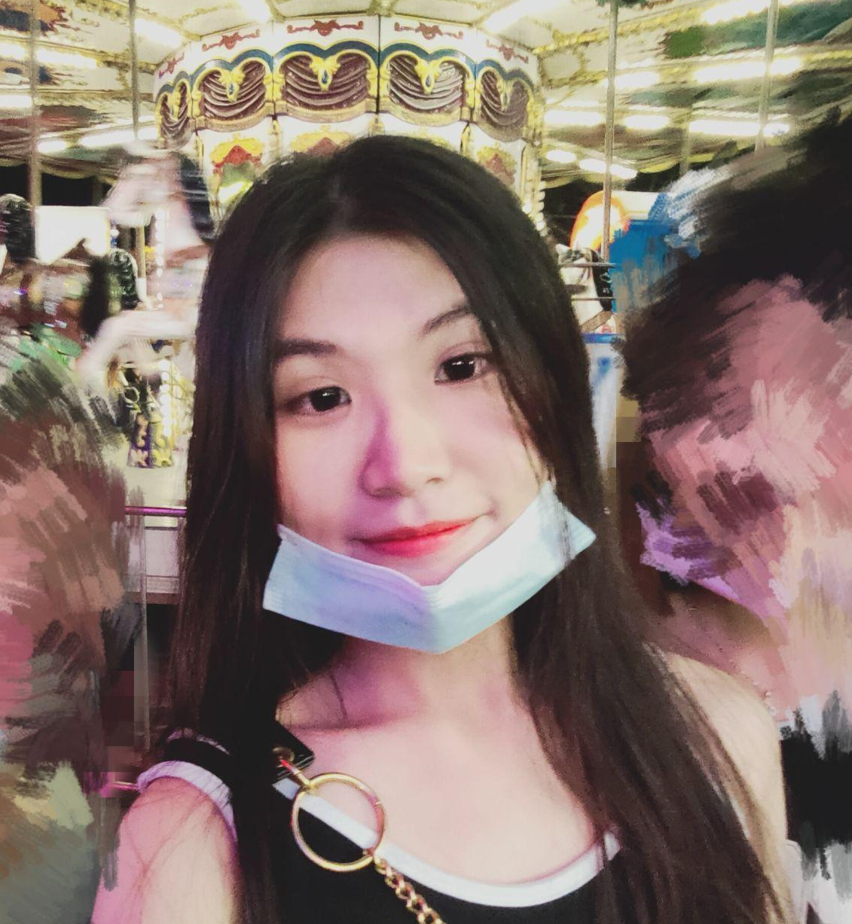
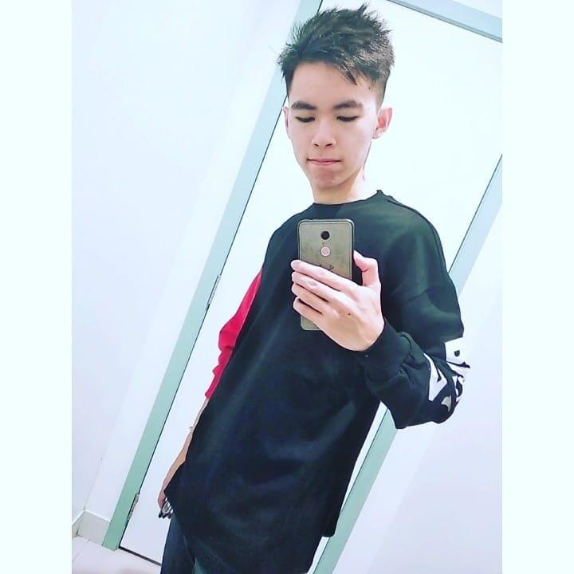
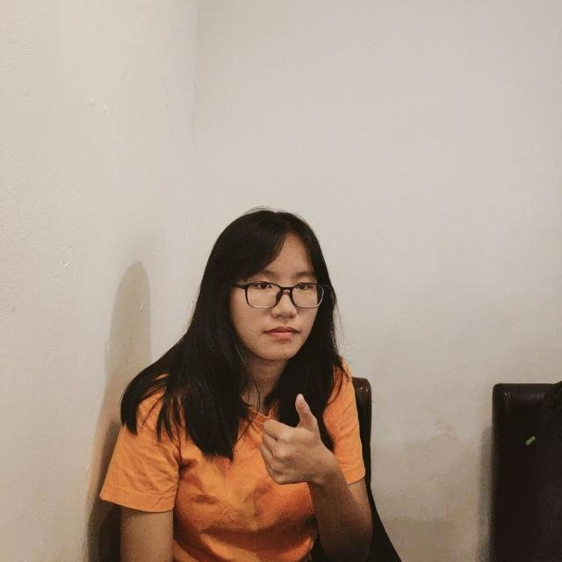
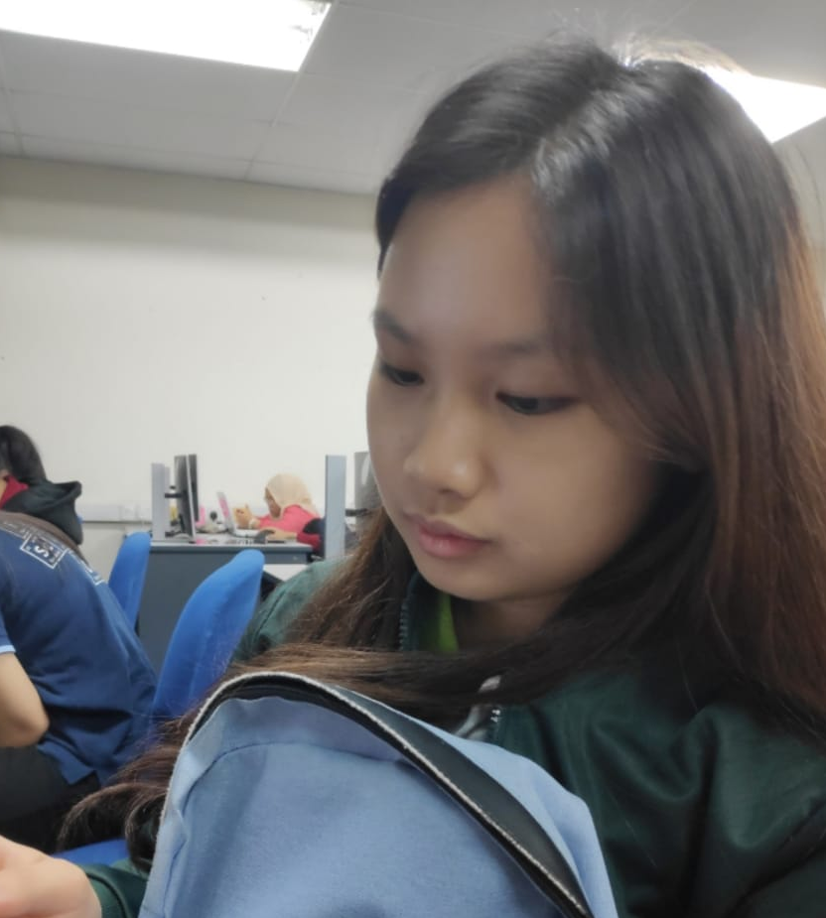
TEAM ARIGATO
Ng Mei Hui
Kiew Xue Kee
Yu Kah Wei
Soo Toh Xin Hui
Lim Chin Qing

Slide 3
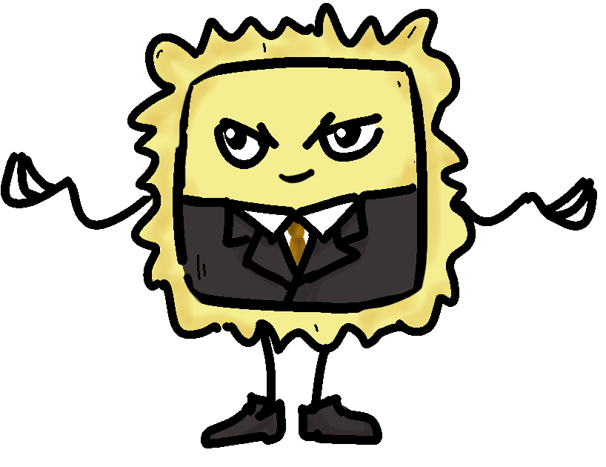

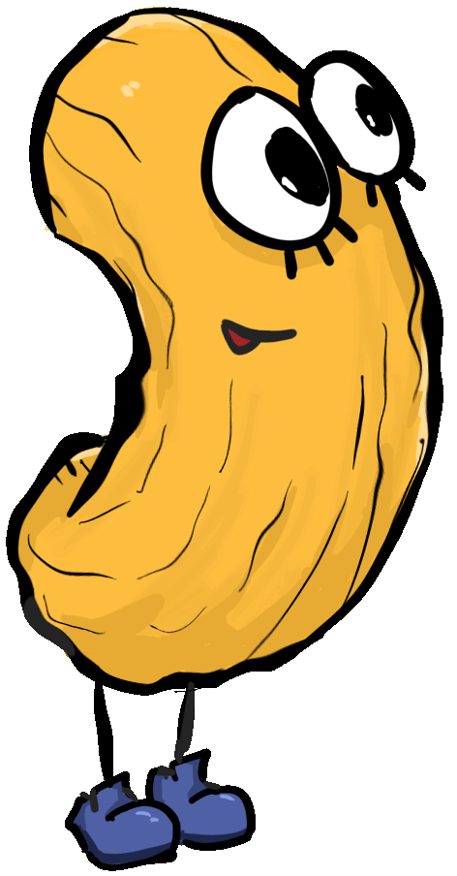
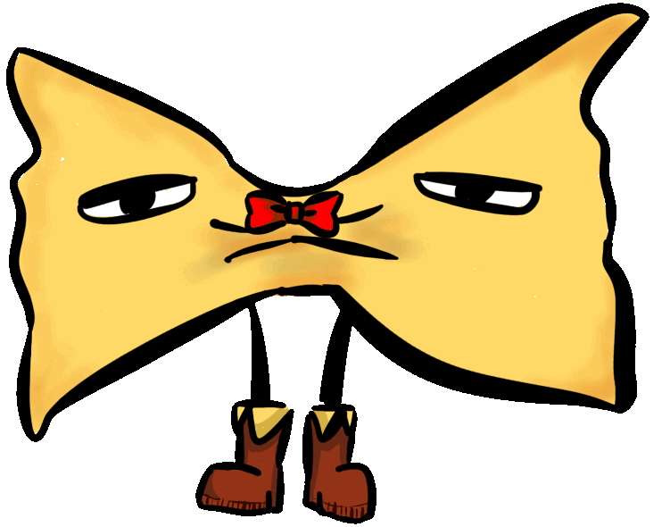
GAME STORY
Rabion, the deacon of the Pasta Harmonia gathered the pasta fellas around and made a big announcement:
A holy quest has been passed down to the pastas to help the player in gaining the perfect pitch skill and save the world by creating the best pasta dish through music.
Be the hero and hop on the journey with the cute pastas to complete the quest!

Slide 4
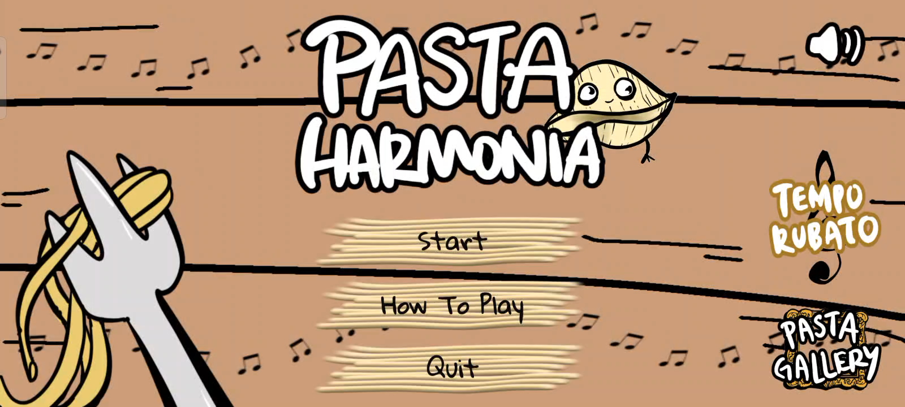

Slide 5





UNIQUE SELLING POINTS
IT’S SIMPLE!
IT’S HAND-DRAWING!
Simple but challenging gameplay.
.
Unique hand-drawing user interface.
IMPROVE YOUR SKILLS!
INTERESTING!
Get to know different kind of pasta by visualizing them in the game.
Improve sense of pitch, memory and concentration
VARIOUS COMBINATION!
Can create different type of game mode

Slide 6

MONETIZATION
IN-APP
PURCHASES
IN - APP
ADS
SUBSCRIPTION
- Special pasta characters
- pasta skin
Ads-removal
- replaying music notes
- filling one of the answers

Slide 7
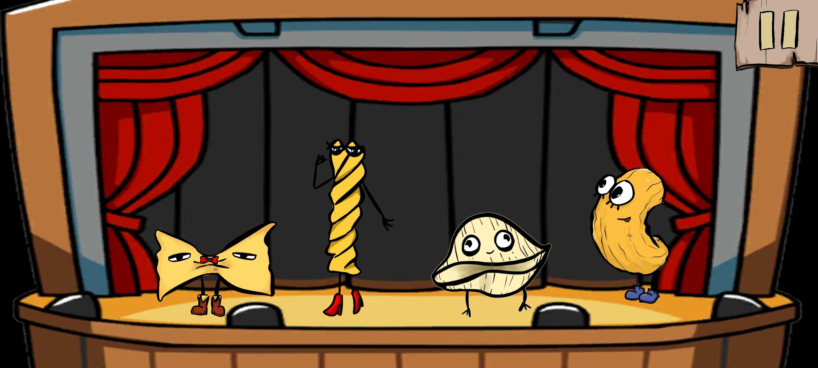
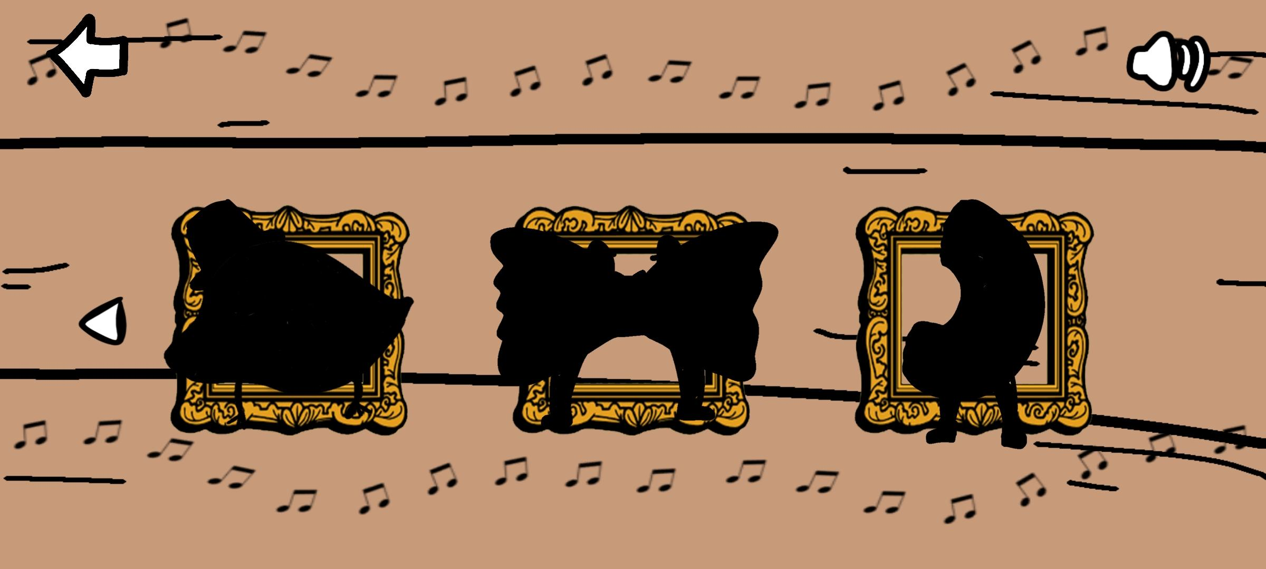
FUTURE PLAN
Tempo Rubato
Free play mode. The players can play the notes freely. They can even compose a song here or follow the music sheet provided! The notes can be played will increase as soon as the player unlock more pasta character. Unlock skin can be used here to customize your pasta characters.

Slide 8
Pasta Fashion
Surprise Meals
The pasta will have their own fashion too! Various type of pasta skin can be bought from shop or get limited skin during special event.
In tempo rubato, play certain notes during festival season to enter a secret level. Unlock special character or skin of pasta after clearing the levels.
Seasoning Harmony
Kitchen Troublemaker
Harmony from seasoning increases the difficulty of game.
There is disturbance during the performance! Try to overcome it and find the correct notes.

Slide 9
Thank You Q & A

